Slide 1
Strategic Human Resource Management
Lecture II

Slide 2
Learning Outcomes
Discuss SHRM Strategies
SHRM Tools
Different Roles of HR Manager
A model for SHRM

Slide 3
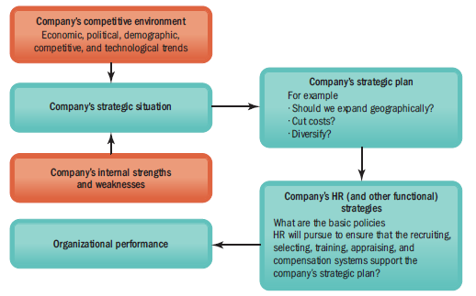
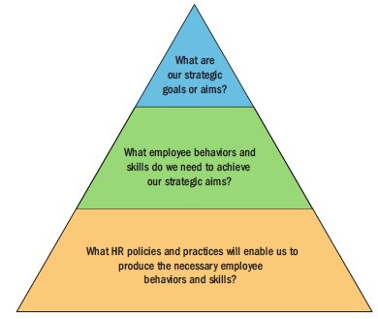
Strategic human resource management means formulating and executing human resource policies and practices that produce the employee competencies and behaviors the company needs to achieve its strategic aims.
Strategic Human Resource Management
https://www.youtube.com/watch?v=llTvxMRJsHQ

Slide 4
Strategic Human Resource Management
Involves the development of a consistent and aligned collection of practices, programs, and policies to facilitate the achievement of the organization’s strategic objectives.
Requires abandoning the mindset and practices of “personnel management” and focusing on strategic issues than operational issues.
Integration of all HR programs within a larger framework, facilitating the organization’s mission and its objectives.

Slide 6
Discuss SHRM Strategies

Slide 7
SHRM Strategies
Commitment Strategy
Compliance Strategy
Paternalistic Strategy
Collaborative Strategy, and
Optimum Utilization of Resources
Video

Slide 8
SHRM Tools

Slide 9
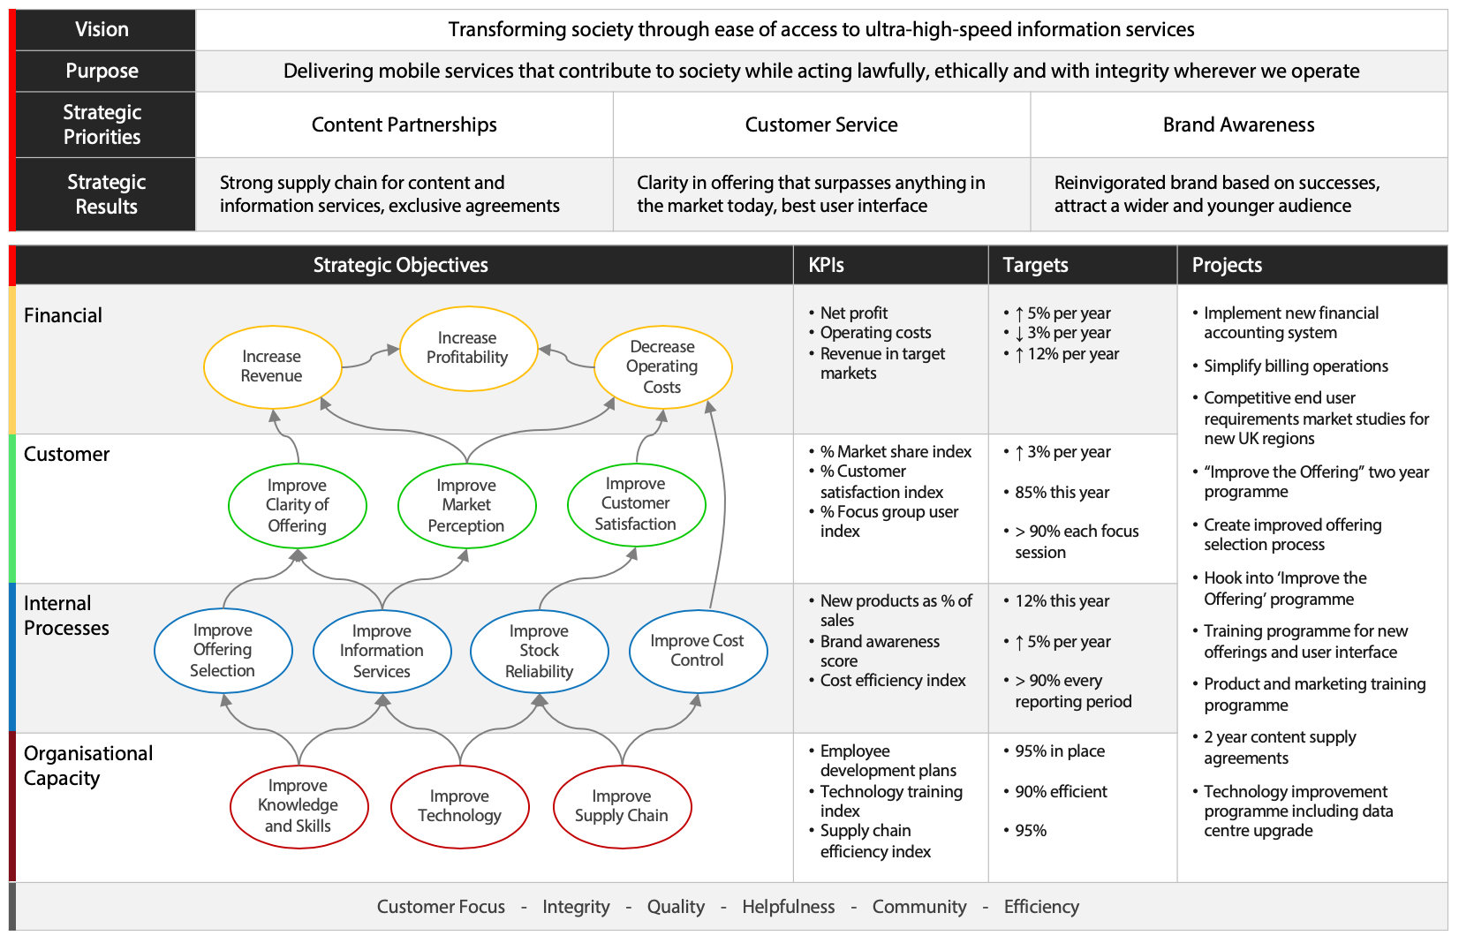

Slide 10
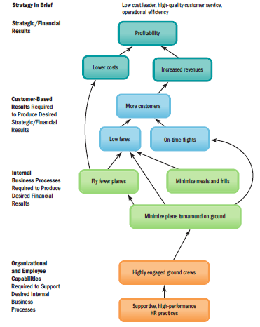

Slide 11
Manager

Slide 12
Horizontal Integration in HR Practices
The human resource department works hard to maintain corporate partnership with individual managers
The human resource department regularly checks with other departments to identify organizational training needs
The human resource department supports departmental managers in carrying out critical human resource management functions as part of their core functions and activities.

Slide 13
Andrew McLean from the Harvard Business School Possible Strategic Role Accepted by HR
Future / Strategic Focus
Strategic
Partner
Change
Agent
Process
(hard)
People
(soft)
Administrative
Expert
Employee
Champion
Day-to-Day / Operational Focus

Slide 14
A model for SHRM

Slide 15
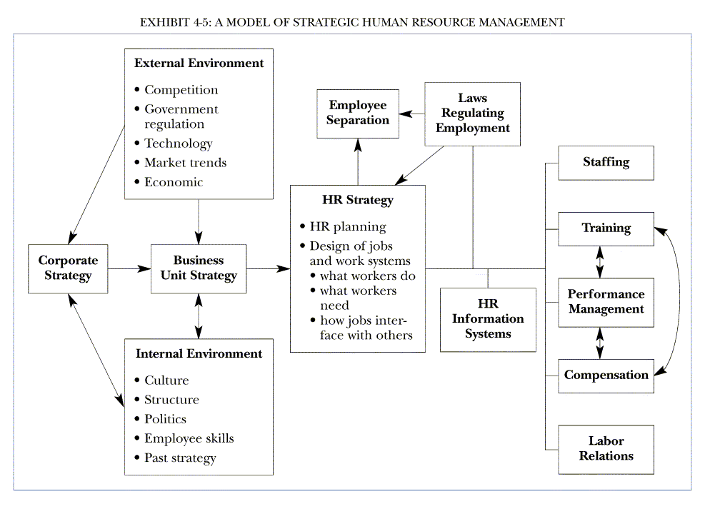

Slide 16
Thank You

